Slide 1
Maximize your FLL Potential!!!
7
PetaBytes
Ram Boreda
FLL Coach for 3 Years- ROBOForce
FTC Coach – Techie Titans Team #9901
Notes:
This template can be used as a starter file for presenting training materials in a group setting.
Sections
Right-click on a slide to add sections. Sections can help to organize your slides or facilitate collaboration between multiple authors.
Notes
Use the Notes section for delivery notes or to provide additional details for the audience. View these notes in Presentation View during your presentation.
Keep in mind the font size (important for accessibility, visibility, videotaping, and online production)
Coordinated colors
Pay particular attention to the graphs, charts, and text boxes.
Consider that attendees will print in black and white or grayscale. Run a test print to make sure your colors work when printed in pure black and white and grayscale.
Graphics, tables, and graphs
Keep it simple: If possible, use consistent, non-distracting styles and colors.
Label all graphs and tables.

Slide 2
Goals for Today!
Share sample “Best Practices”
How/Where to learn and get most out of FLL?
Build a “Peer Learning Network”
Have Fun!!!
Notes:
Give a brief overview of the presentation. Describe the major focus of the presentation and why it is important.
Introduce each of the major topics.
To provide a road map for the audience, you can repeat this Overview slide throughout the presentation, highlighting the particular topic you will discuss next.

Slide 3
Resources
Techie Titans Website
Techie TItans Facebook Page
Techie Titans Youtube Channel
Techie TItans GitHub
Techie Titans Drive
Techie Titans Slack

Slide 4
Outline
Introductions – Mentors & Attendees
Common Myths Vs. Facts
Holistic Approach to FLL
Learning Resources
Best Practices for ALL aspects of FLL
Special Focus on Research & CORE Values
Tournament Day Tips
Live Demo of our Robot
Q & A and 1:1 Mentoring Opportunities
Have Fun!!!
Notes:
Give a brief overview of the presentation. Describe the major focus of the presentation and why it is important.
Introduce each of the major topics.
To provide a road map for the audience, you can repeat this Overview slide throughout the presentation, highlighting the particular topic you will discuss next.

Slide 5
Introductions
RoboForce – Top 10 in State Championship in 2014 & 2015
7 PetaBytes – Robo Performance 1st Place 2015
LegoDominators – Top 10 State Championship in 2015
TechieTitans – FTC Team #9901 2016
Notes:
Give a brief overview of the presentation. Describe the major focus of the presentation and why it is important.
Introduce each of the major topics.
To provide a road map for the audience, you can repeat this Overview slide throughout the presentation, highlighting the particular topic you will discuss next.

Slide 6
Quick Poll of the Audience
How many of you are Rookie teams?
Is your team registered with FLL?
Are you subscribed to VADCFLL forum?
Have you read the Robot Missions and Research Project?
Do you know ALL the CORE Values?
Built a basic Robot that can go straight make turns?
Proportional Line Follower?
Short-list of topics for Research Project?
Identified Industry Experts?
Notes:
Give a brief overview of the presentation. Describe the major focus of the presentation and why it is important.
Introduce each of the major topics.
To provide a road map for the audience, you can repeat this Overview slide throughout the presentation, highlighting the particular topic you will discuss next.

Slide 7
Common Myths & Mistakes
Robot Performance/Score is very critical - NO
Teams spend >75% of the time on Robot – Don’t… BIG MISTAKE
Tons of Internet Research & not enough external validation – Big MISS
Build complex robot using ALL Sensors
Big, bulky, complex attachments for each mission – NO, NO, NO
CORE Values an after-thought – BIG MISTAKE
Coach becomes the “doer” – BIG NO
Notes:
Give a brief overview of the presentation. Describe the major focus of the presentation and why it is important.
Introduce each of the major topics.
To provide a road map for the audience, you can repeat this Overview slide throughout the presentation, highlighting the particular topic you will discuss next.

Slide 8
Success @ Regional Tournaments
Tournament – Celebration Event!!!
Advancement Criteria below
Top 40% of teams
Judged for
Robot Performance Score

Slide 9
Holistic Approach to FLL Success
Focused Coach for each aspect
Instill CORE Values into the DNA of the Team
Early start on Research Project
Robot Design and Attachments
EV3 Programming
Mission Strategy
Mock Tournaments
Outreach Events
Tournament Preparation
Notes:
Give a brief overview of the presentation. Describe the major focus of the presentation and why it is important.
Introduce each of the major topics.
To provide a road map for the audience, you can repeat this Overview slide throughout the presentation, highlighting the particular topic you will discuss next.

Slide 10
Bottomline Upfront – Learning
https://theipals.wordpress.com/
https://www.youtube.com/channel/UCHT1IxlYMY4Z8hGPZouWNdg
https://theipals.files.wordpress.com/2014/11/howkidslearn-ebook-final_may-11.pdf
https://www.youtube.com/watch?v=NlxvSdTokuQ
https://www.youtube.com/watch?v=wzDjg595AiU
https://youtu.be/dJSeMeAGmXE
http://va-dcfll.org/calendar/
http://www.fllstartingpoint.com/
http://ev3lessons.com/index.html#en-us

Slide 11
Robo Design
Simple, Compact, Stable… Do NOT over-engineer
Multi-Functional Attachments
Navigation
Margin for Error & Variability
Go straight, Follow Lines, Start/Stop at Guide Posts, Consistent Starting Positions
Right & Left Edge Following
Consistent 90 degree turns
Use Light and Touch Sensors as a minimum
“Aligners” for back-wall
Notes:
Give a brief overview of the presentation. Describe the major focus of the presentation and why it is important.
Introduce each of the major topics.
To provide a road map for the audience, you can repeat this Overview slide throughout the presentation, highlighting the particular topic you will discuss next.

Slide 12
Robo Design
Designed like a human
2 front Wheels, Color sensor, Medium motors..
Use of Marble as back wheel for sharp turns
Medium Motors
Like arms
Left was taller for attachments of different heights
Use of 3 Axels instead of one
Bumpers on front wheels to push aside “debris”
Back plate for aligning and squaring off
Starter jigs for consistent positioning
Notes:
Give a brief overview of the presentation. Describe the major focus of the presentation and why it is important.
Introduce each of the major topics.
To provide a road map for the audience, you can repeat this Overview slide throughout the presentation, highlighting the particular topic you will discuss next.

Slide 13
Robo Design… Cont’d
Missions
Simple, multi-attachment “Adapters”
Easy to swap in and swap out
Use Light and Touch Sensors as a minimum
Both Sides + High & Low
Margin of error and variability
Optimized mechanical design
Use Gears to “translate” vertical and horizontal range of motion
Notes:
Give a brief overview of the presentation. Describe the major focus of the presentation and why it is important.
Introduce each of the major topics.
To provide a road map for the audience, you can repeat this Overview slide throughout the presentation, highlighting the particular topic you will discuss next.

Slide 14
Robot Test Plan
Center of Gravity test - robot needs to be balanced so that it doesn't tip over or wobble - the center of gravity should be inside the wheelbase, close to the center of wheelbase
Straight-Line test - a robot that doesn't go straight will not give consistent result
Turning test - Robot needs to turn consistently a) one motor turn - circular turn b) bot motor turn (in two different speed) - wide turn c) pivot turn (one motor moves forward and the other backward) - in-place rotation

Slide 15
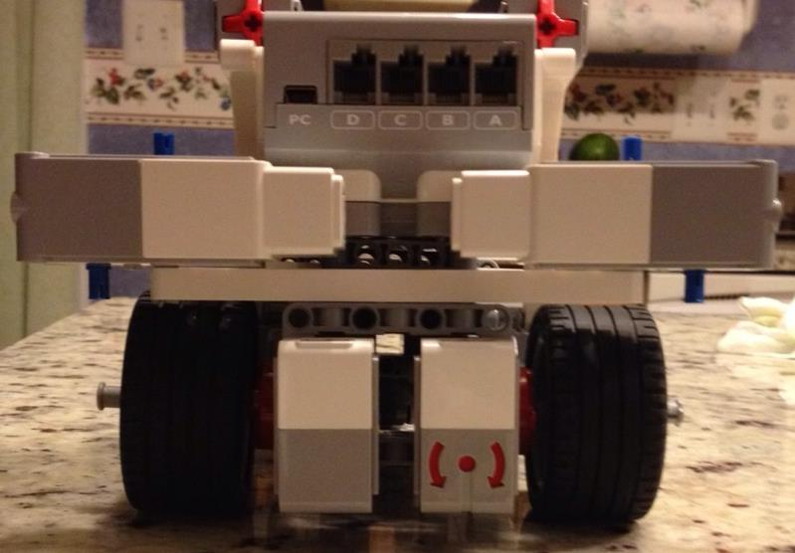
Robo Design Examples

Slide 16
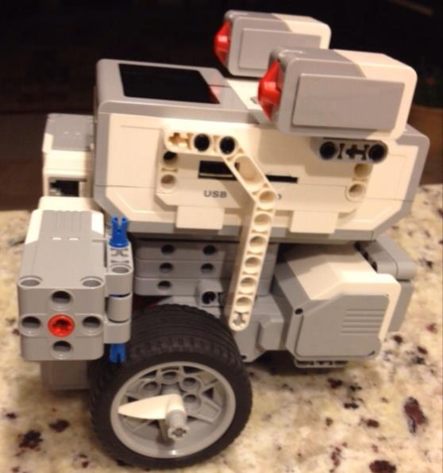
Robo Design Examples

Slide 17
EV3 Programming
Assume variability, imperfect conditions
Hey! Prepare for real life challenges
Proportional Line Follower (Right &Left Edges)
My Blocks
Trial and Error – Allow kids to learn
Pseudocode to demonstrate logic
Backups and print outs of the programs
Documentation
Notes:
Give a brief overview of the presentation. Describe the major focus of the presentation and why it is important.
Introduce each of the major topics.
To provide a road map for the audience, you can repeat this Overview slide throughout the presentation, highlighting the particular topic you will discuss next.

Slide 18
EV3 Programming… Cont’d
Start, Stop, Turns on Lines, Edges, Colors
Source code control
Learn to debug EV3 programs
Trial and Error too expensive
Cost & feasibility of solution
Usability and adoption
Potential roadblocks and risks
Notes:
Give a brief overview of the presentation. Describe the major focus of the presentation and why it is important.
Introduce each of the major topics.
To provide a road map for the audience, you can repeat this Overview slide throughout the presentation, highlighting the particular topic you will discuss next.

Slide 19
Game Strategy
Divide up challenge into multiple zones
Group missions based on zones or attachments
Minimize turns, swapping attachments
Think “out of the box”
Notes:
Give a brief overview of the presentation. Describe the major focus of the presentation and why it is important.
Introduce each of the major topics.
To provide a road map for the audience, you can repeat this Overview slide throughout the presentation, highlighting the particular topic you will discuss next.

Slide 20
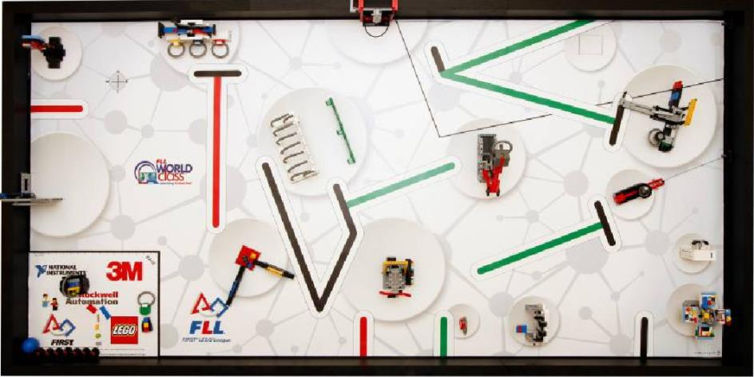
FLL 2015 Game Strategy

Slide 21
Game Strategy Test Plan
Speed test - can the missions be completed in desired time? - can the mission be completed faster
Consistency test - can the missions be completed consistently?
Maximizing scores - can we do more missions in one round (without coming back to base)? - can we regroup missions to save time (by using same attachment)?

Slide 22
Research Project
Practical, Original, Achievable – INNOVATE!!
Research ALL possible sources
Validate ideas with EXPERTS in the field
Document ALL ideas including discards
Build Hands-on prototype
Creative and impactful presentation
SKIT or Lively presentation is a MUST!
Practice, practice, practice with a stop watch
Present your solution to diverse audience
Notes:
Give a brief overview of the presentation. Describe the major focus of the presentation and why it is important.
Introduce each of the major topics.
To provide a road map for the audience, you can repeat this Overview slide throughout the presentation, highlighting the particular topic you will discuss next.

Slide 23
Research Project… Cont’d
Research Process very important
Research Binder
Demonstrate Solution in action
“Business Plan” for your Solution
Cost & feasibility of solution
Usability and adoption
Potential roadblocks and risks
Notes:
Give a brief overview of the presentation. Describe the major focus of the presentation and why it is important.
Introduce each of the major topics.
To provide a road map for the audience, you can repeat this Overview slide throughout the presentation, highlighting the particular topic you will discuss next.

Slide 24
Our Friend from Fukushima
Mr. Masatoshi Suzuki-San
During Tsunami, he got knocked out at home and fell unconscious
Found himself in a heap of rubble when he regained consciousness
Lost his house and several neighbors, who did not evacuate
Quick Evacuation saved his life
Only a few people evacuated after warning

Slide 25
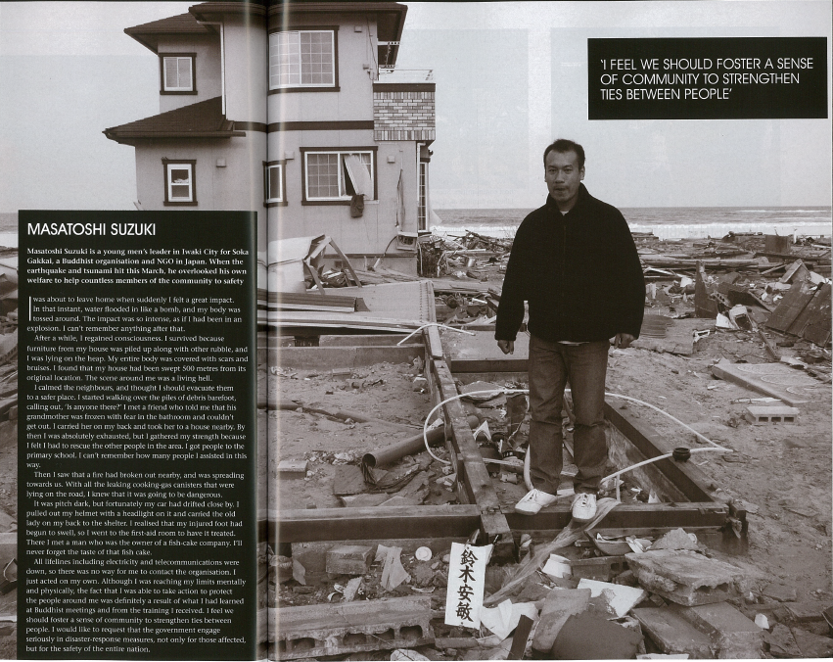
Masatoshi Suzuki-San

Slide 26
Our Special Thanks to Experts!
Nathan Hagan – Naval Research Scientist
Naval Surface Warfare Center
Claudia C. Marin-Artieda – Assistant Professor
Howard University
Masatoshi Suzuki-San – Community Leader
Soka Gakkai NGO, Fukushima, Japan
Capt II Kit Hessel – Station Commander
Fairfax County Fire & Rescue Dept, VA Task Force
Dr. Harry Yeh – Oregon St. U. Tsunami Center
Dr. Subramanian – NanoScientist
Dr. Paul Dev – Research Scientist

Slide 27
CORE Values….in every meeting
CORE Values exercises/tasks
Demonstrate/reiterate CORE Values
4-8 Outreach Events
Mentor/Collaborate with other teams
Allow team members to settle into natural ryhthm & roles:
Timekeeper
Leader(s)
Coordinators
Doers
Notes:
Give a brief overview of the presentation. Describe the major focus of the presentation and why it is important.
Introduce each of the major topics.
To provide a road map for the audience, you can repeat this Overview slide throughout the presentation, highlighting the particular topic you will discuss next.

Slide 28
What are CORE Values?
We are a team.
We do the work to find solutions with guidance from our coaches and mentors.
We know our coaches and mentors don't have all the answers; we learn together.
We honor the spirit of friendly competition.
What we discover is more important than what we win.
We share our experiences with others.
We display Gracious Professionalism® and Coopertition® in everything we do.
We have FUN!

Slide 29
CORE Values – Tournament Practice
Clarification/Understanding
Brain-storming – Discuss ideas/options
Task distribution
Coordination
Execution – All in regardless of chosen idea
Refinement / Optimization
Time Keeper
Participation by ALL members
NO Dissent
NO talking over each other
Notes:
Give a brief overview of the presentation. Describe the major focus of the presentation and why it is important.
Introduce each of the major topics.
To provide a road map for the audience, you can repeat this Overview slide throughout the presentation, highlighting the particular topic you will discuss next.

Slide 30
Tournament Day Tips
Dress up, stand out, enter & leave w/ a bang!
Calibrate Sensors in the Pit Area
Sign up for Practice Tables early
No major design or programming changes
No adult/coach intervention & assistance
Projector, Electric outlets NOT available
Demonstrate CORE values through out the day
Mingle, share, learn, dance and HAVE FUN!
Notes:
Give a brief overview of the presentation. Describe the major focus of the presentation and why it is important.
Introduce each of the major topics.
To provide a road map for the audience, you can repeat this Overview slide throughout the presentation, highlighting the particular topic you will discuss next.

Slide 31
Communication & Collaboration
Google Docs
Slack & Whatsapp
YouTube
Pseudocode to demonstrate logic
Backups and print outs of the programs
Documentation
Notes:
Give a brief overview of the presentation. Describe the major focus of the presentation and why it is important.
Introduce each of the major topics.
To provide a road map for the audience, you can repeat this Overview slide throughout the presentation, highlighting the particular topic you will discuss next.

Slide 32
Resources
VADCFLL Mailing List
FIRST/FLL EXPO at USPTO
YouTube Channels for Mission Videos
Mock Tournaments in DC/MD/VA
Notes:
Give a brief overview of the presentation. Describe the major focus of the presentation and why it is important.
Introduce each of the major topics.
To provide a road map for the audience, you can repeat this Overview slide throughout the presentation, highlighting the particular topic you will discuss next.

Slide 33
Questions?

